Slide 1
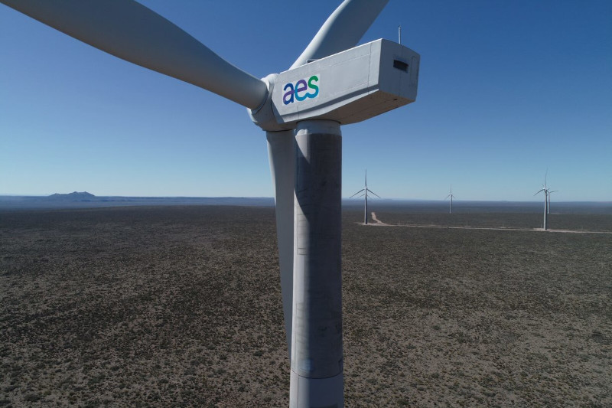

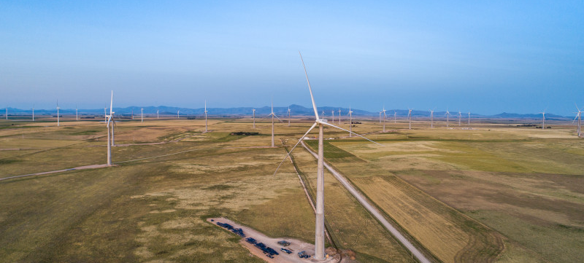
Air quality
AES Argentina
January 2026

Slide 2
UTN Station
No values above the legal limit were observed.

Slide 3
San Nicolás Thermal Power Plant
There were no values that exceeded the limit.

Slide 4
Saavedra Air Quality Monitoring Station
There were no values that exceeded the limit.

